Slide 1

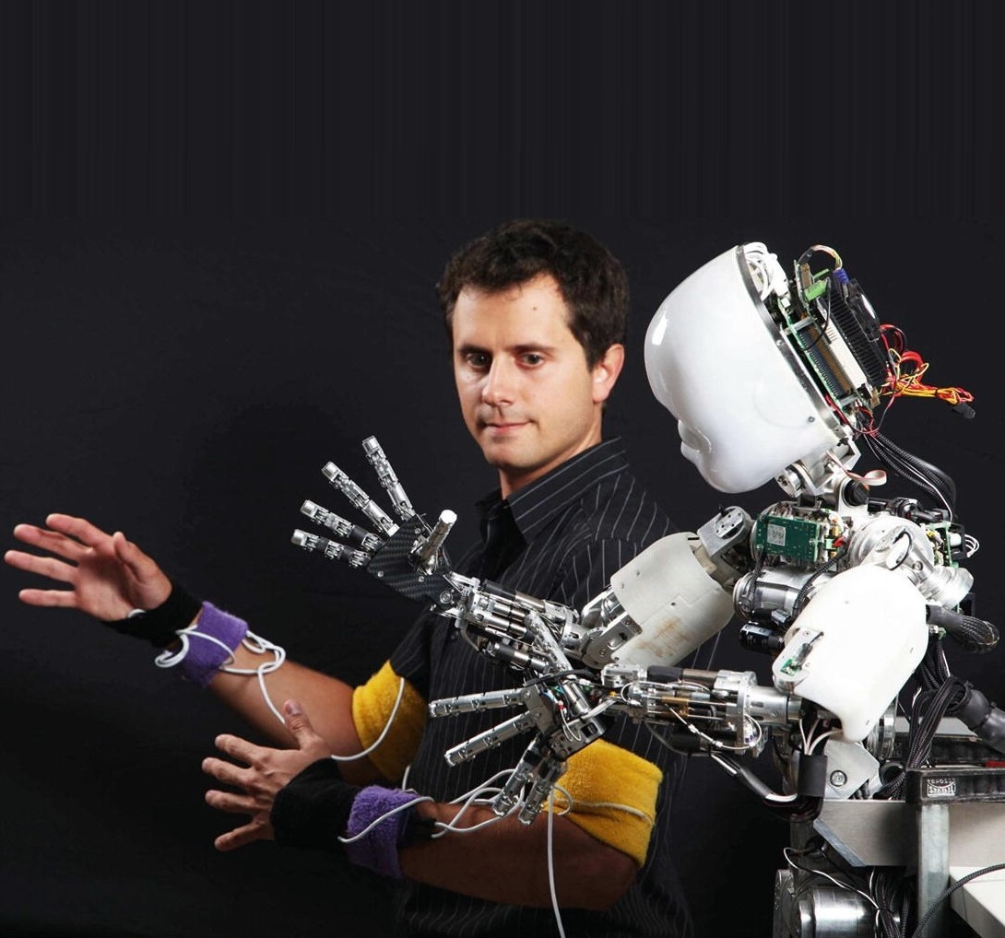
Meeting
23-2-2022
Rosa Maessen

Slide 2
Proposal 1 – Research question
“Can skill mutation result in better performance when doing
robot to robot learning?”

Slide 3
Proposal 1 – Sub-questions
How can the performance of a robot be defined?
How does the skill of a robot mutates during robot to robot learning?
How does the skill of different types of robots mutates during robot to robot learning?

Slide 4
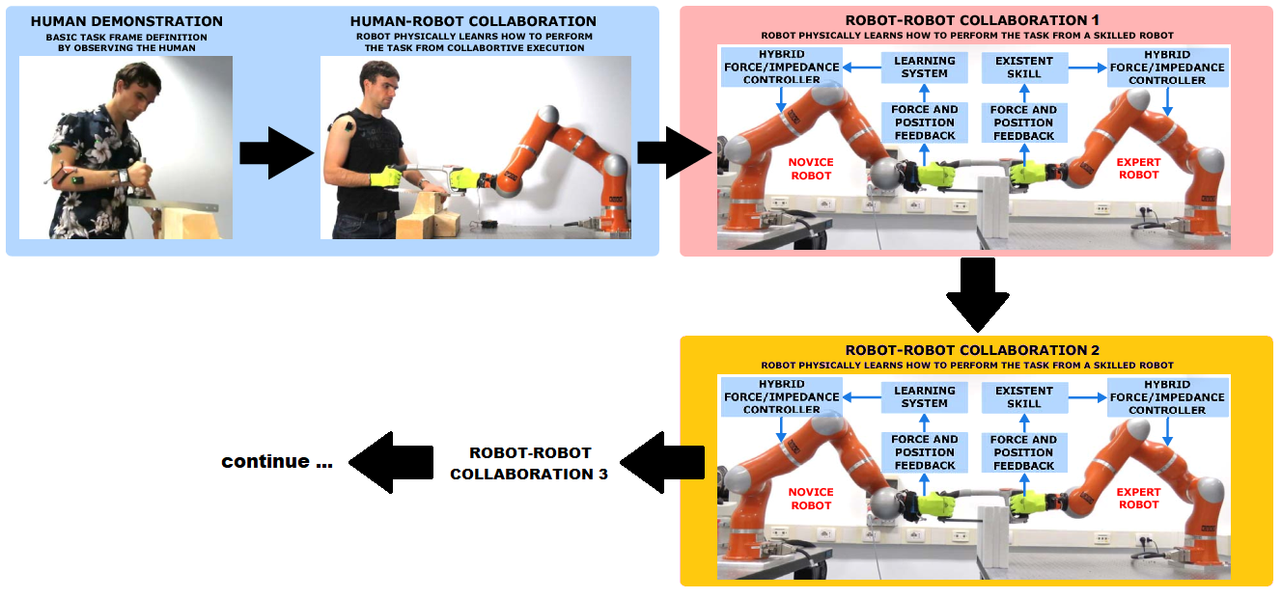
Proposal 1 – Method
Experiment 1
Peternel, L., & Ajoudani, A. (2017, November). Robots learning from robots: A proof of concept study for co-manipulation tasks. In 2017 IEEE-RAS 17th International Conference on Humanoid Robotics (Humanoids) (pp. 484-490). IEEE.

Slide 5
Proposal 1 – Method
Experiment 1
Option 1
Observation
Human-robot collaboration
Save learned policy
Robot to Robot
Completely compliant
Learning phase
Novice has become an expert
Save learned policy
Repeat step 3 until all N robots have learned
Execute task N times (both robots use saved policy of same robot)
Option 2
Observation
Human-robot collaboration
Robot to Robot
Completely compliant
Learning phase
Novice has become an expert
Execute task (robots both use a different policy)
Repeat step 3 until all N robots have learned

Slide 6
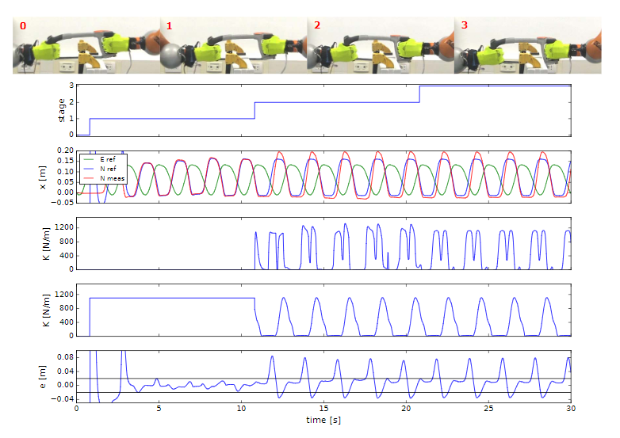
Proposal 1 – Method
Experiment 1
Option 1
Option 2
(2x)

Slide 7
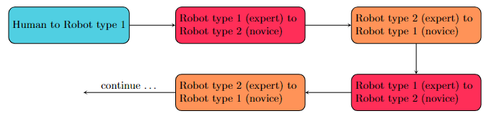
Proposal 1 – Method
Experiment 2

Slide 8
Proposal 1 – Method
Experiment 2
Option 1
Use similar type robot for experiments
Save policy after learning
Execute after all robots have learned
Option 2
Use different types of robots for experiments
Execute task directly after learning

Slide 9
Proposal 2 – Research question
“Does random mutation of a reward function result in useful skills for robots?”

Slide 10
Proposal 2 – Sub-questions
How can a reward function be generic, defined for different robotic tasks?
Does changing the parameters of a reward function result in different robotic behavior while executing the same task?
Can reward functions, obtained for a certain task, be useful for others?

Slide 11
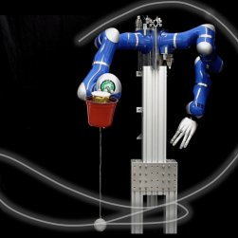


Proposal 2 – Method
Experiment 1
Two-part reward function
If the ball reaches the height of the cup
Otherwise
Carlos Celemin et al. “Reinforcement learning of motor skills using policy search and human corrective advice”. In: The International Journal of Robotics Research 38.14 (2019), pp. 1560–1580.

Slide 12
Proposal 2 – Method
Experiment 1
Two-part reward function
If the ball reaches the height of the cup
Otherwise
1
2
Carlos Celemin et al. “Reinforcement learning of motor skills using policy search and human corrective advice”. In: The International Journal of Robotics Research 38.14 (2019), pp. 1560–1580.

Slide 13
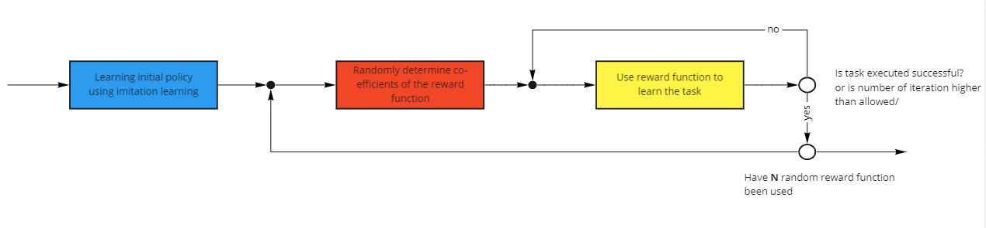
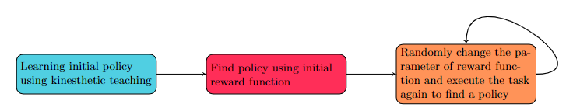
Proposal 2 – Method
Experiment 1

Slide 14
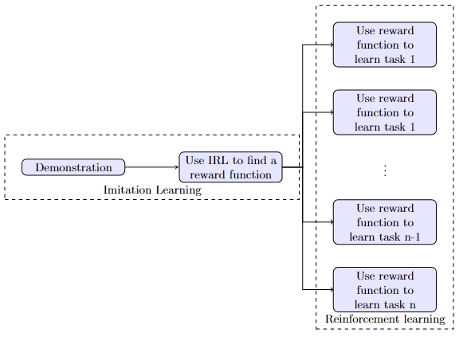
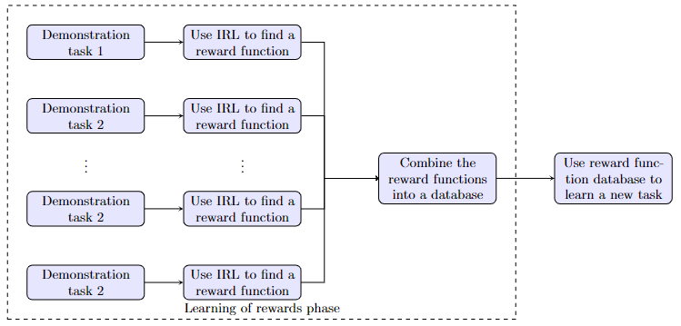
Proposal 2 – Method
Experiment 2
Option 1
Option 2

